Slide 1
Chapter 5
Digital Design and Computer Architecture, 2nd Edition
David Money Harris and Sarah L. Harris

Slide 2
Introduction
Digital building blocks:
Gates, multiplexers, decoders, registers, arithmetic circuits, counters, memory arrays, logic arrays
Building blocks demonstrate hierarchy, modularity, and regularity:
Hierarchy of simpler components
Well-defined interfaces and functions
Regular structure easily extends to different sizes

Slide 3
Subtracter
Adder can add positive and negative numbers using two’s complement representation.
Subtraction: inverting the bits and adding 1.
Flipping the sign of a two’s complement number is done by inverting the bits and adding 1.

Slide 4
Comparator: Equality
A comparator determines whether two binary numbers are equal or if one is greater or less than the other.
An equality comparator produces a single output indicating whether A is equal to B

Slide 5
Comparator: Less Than
Magnitude comparison is done by computing A - B and looking at the sign (most significant bit) of the result.
If the result is negative (i.e., the sign bit is 1), then A is less than B. otherwise A is greater than or equal to B

Slide 6
Arithmetic/Logic Unit (ALU)
An ALU combines a variety of mathematical and logical operations into a single unit. (addition, subtraction, magnitude comparison, AND, OR operations)
A control signal F specifies which function to perform
F_{2:0} | Function
000 | A & B
001 | A | B
010 | A + B
011 | not used
100 | A & ~B
101 | A | ~B
110 | A - B
111 | SLT

Slide 7
ALU Design
F_{2:0} | Function
000 | A & B
001 | A | B
010 | A + B
011 | not used
100 | A & ~B
101 | A | ~B
110 | A - B
111 | SLT
BB

Slide 8
ALU Design
BB is either B or ~B, depending on F₂.
If F_{1:0} = 00, the output multiplexer chooses A AND BB.
If F_{1:0} = 01, the ALU computes A OR BB.
If F_{1:0} = 10, the ALU performs addition or subtraction.
If F₂ = 0, the ALU computes A+B,
If F₂ = 1, the ALU computes A + ~B + 1 = A – B.
When F_{2:0} = 111, the ALU performs the set if less than (SLT) operation.
When A < B, Y =1, otherwise Y = 0.
i.e., Y is set to 1 if A is less than B.
F_{2:0} | Function
000 | A & B
001 | A | B
010 | A + B
011 | not used
100 | A & ~B
101 | A | ~B
110 | A - B
111 | SLT

Slide 9
ALU Design
BB
The zero extend unit produces an N-bit output by concatenating its 1-bit input with 0’s in the most significant bits.
The sign bit (the N-1th bit) of S is the input to the zero extend unit.

Slide 10
Example 5.3 - Set Less Than (SLT)
Configure 32-bit ALU for SLT operation.
Suppose A = 25 and B = 32
Show the control signals and output Y.
BB

Slide 11
Example 5.3 - Set Less Than (SLT)
Configure 32-bit ALU for SLT operation: A = 25 and B = 32
A < B, so Y should be 32-bit representation of 1 (0x00000001)
F_{2:0} = 111
F₂ = 1 (adder acts as subtractor), so 25 - 32 = -7
-7 has 1 in the most significant bit (S₃₁ = 1)
F_{1:0} = 11 multiplexer selects Y = S₃₁ (zero extended) = 0x00000001.
BB

Slide 12
Shifters and Rotators
Shifters and rotators move bits and multiply or divide by powers of 2.
Logical shifter: shifts value to left (LSL) or right (LSR) and fills empty spaces with 0’s
Ex: 11001 >> 2 =
Ex: 11001 << 2 =
Arithmetic shifter: same as logical shifter. But on right shift, fills empty spaces with the old most significant bit (msb). Useful for multiplying and dividing signed numbers
Ex: 11001 >>> 2 =
Ex: 11001 <<< 2 =
Rotator: rotates bits in a circle, such that bits shifted off one end are shifted into the other end
Ex: 11001 ROR 2 =
Ex: 11001 ROL 2 =

Slide 13
Shifters
Logical shifter:
Ex: 11001 >> 2 = 00110
Ex: 11001 << 2 = 00100
Arithmetic shifter:
Ex: 11001 >>> 2 = 11110
Ex: 11001 <<< 2 = 00100
Rotator:
Ex: 11001 ROR 2 = 01110
Ex: 11001 ROL 2 = 00111

Slide 14
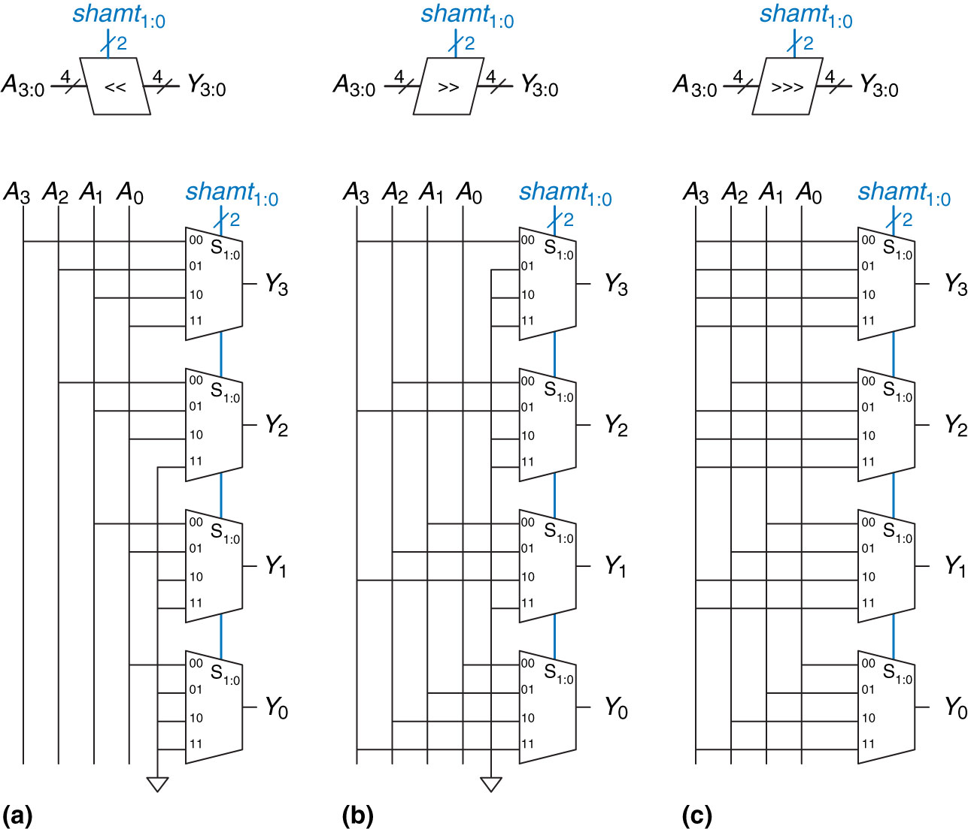
Shifter Design
An N-bit shifter can be built from N N:1 multiplexers
(a) Shift left (b) logical shift right (c) arithmetic shift right

Slide 15
Shifter Design
Shift left
A left shift by N bits multiplies the number by 2^{N}.
For example, 000011₂ << 4 = 110000₂ is equivalent to 3₁₀ x 2⁴ = 48₁₀

Slide 16
Shifter Design
An arithmetic right shift by N bits divides the number by 2^{N}.
For example, 11100₂ >>> 2 = 11111₂ is equivalent to -4₁₀ ÷ 2² = -1₁₀.

Slide 17
Shifters as Multipliers, Dividers
A << N = A × 2^{N}
Example: 00001 << 2 =
Example: 11101 << 2 =
A >>> N = A ÷ 2^{N}
Example: 01000 >>> 2 =
Example: 10000 >>> 2 =

Slide 18
Shifters as Multipliers, Dividers
A << N = A × 2^{N}
Example: 00001 << 2 = 00100 (1 × 2² = 4)
Example: 11101 << 2 = 10100 (-3 × 2² = -12)
A >>> N = A ÷ 2^{N}
Example: 01000 >>> 2 = 00010 (8 ÷ 2² = 2)
Example: 10000 >>> 2 = 11100 (-16 ÷ 2² = -4)

Slide 19
Number Systems
Numbers we can represent using binary representations
Positive numbers
Unsigned binary
Negative numbers
Two’s complement
Sign/magnitude numbers
What about fractions?

Slide 20
Numbers with Fractions
Two common notations:
Fixed-point: binary point fixed
Floating-point: binary point floats to the right of the most significant 1

Slide 21
Fixed-Point Numbers
6.75 using 4 integer bits and 4 fraction bits:
Binary point is implied
The number of integer and fraction bits must be agreed upon beforehand

Slide 22
Fixed-Point Number Example
Represent 7.5₁₀ using 4 integer bits and 4 fraction bits.

Slide 23
Fixed-Point Number Example
Represent 7.5₁₀ using 4 integer bits and 4 fraction bits.
7 = 0111
0.5 = 2⁻¹
Thus, 7.5₁₀ = 0111 1000

Slide 24
Signed Fixed-Point Numbers
Representations:
Sign/magnitude
Two’s complement
Example: Represent -7.5₁₀ using 4 integer and 4 fraction bits
Sign/magnitude:
Two’s complement:

Slide 25
Signed Fixed-Point Numbers
Representations:
Sign/magnitude
Two’s complement
Example: Represent -7.5₁₀ using 4 integer and 4 fraction bits
Sign/magnitude:
11111000
Two’s complement:
1. +7.5: 01111000
2. Invert bits: 10000111
3. Add 1 to lsb: + 1
10001000

Slide 26
Example 5.4
Compute 0.75 + (–0.625) using fixed-point numbers

Slide 27
Example 5.4
Compute 0.75 + (–0.625) using fixed-point numbers
First convert 0.625 to fixed-point binary notation.
0.625 ≥ 2⁻¹, so there is a 1 in the 2⁻¹ column, leaving 0.625 – 0.5 = 0.125.
Because 0.125 < 2⁻², there is a 0 in the 2⁻² column
Because 0.125 ≥ 2⁻³, there is a 1 in the 2⁻³ column, leaving 0.125 – 0.125 = 0.
Thus, there must be a 0 in the 2⁻⁴ column. Putting this all together, 0.625₁₀ = 0000.1010₂.
2⁻¹ = 0.5
2⁻² = 0.25
2⁻³ = 0.125
2⁻⁴ = 0.0625

Slide 28
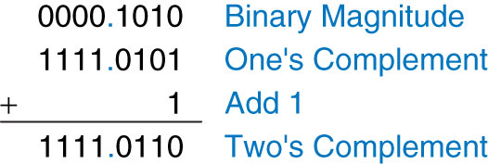
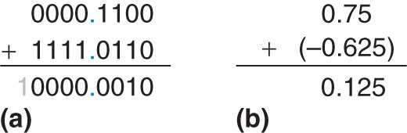
Example 5.4
Use two’s complement representation for signed numbers so that addition works correctly.
Note that the leading 1 in the binary fixed-point addition of Figure (a) is discarded from the 8-bit result.

Slide 29
Exercise 5.25 (b)
Express 42.3125₁₀ in 16-bit fixed point sign/magnitude format with eight integer bits and eight fraction bits.

Slide 30
Exercise 5.25 (b)
Express 42.3125₁₀ in 16-bit fixed point sign/magnitude format with eight integer bits and eight fraction bits.
42₁₀ = 0010 1010₂
0.3125 < 0.5, so there is a 0 in the 2⁻¹ column
0.3125 ≥ 0.25, so there is a 1 in the 2⁻² column, leaving 0.3125 – 0.25 = 0.0625
0.0625 ≥ 0.0625, so there is a 1 in the 2⁻⁴ column
Thus, 0.3125 = 0101 0000
42. 3125 = 0010 1010. 0101 0000

